Slide 1
AI-Augmented Software Development Life Cycle SEZG534
Akshaya Ganesan
CSIS, WILP

Slide 2
Contact Session: 1 - Introduction

Slide 3

Instructor
Akshaya Ganesan
Assistant Professor (Off Campus)
Teaches courses in the areas of Software Engineering which includes Full stack Application development, Microservices, User experience Design and Devops.
Email:akshaya.ganesan@pilani.bits-pilani.ac.in

Slide 4
Q and A
New AI Buzzwords you have heard recently?

Slide 5
Q and A
Where are you currently using AI the most?
A) Writing/refactoring code
B) Writing tests or documentation
C) Debugging errors / reading logs
D) Planning / breakdown of requirements
E) Learning
References and Self Reading

Slide 6
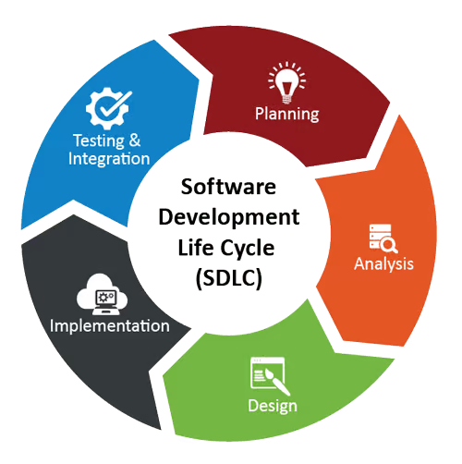
SDLC

Slide 7
SDLC Phases and Roles
SDLC Phase | Primary Responsible Roles | Key Tasks & Artifacts
1. Planning & Feasibility | Product Manager (PM), Engineering Lead, Business Stakeholders | Defines project scope, budget, resource planning, and high-level timelines.
2. Requirements Analysis | Business Analyst (BA), Product Owner (PO) | Gathers user stories, drafts the Software Requirement Specification (SRS), and clarifies acceptance criteria.
3. Design & Architecture | Solutions/System Architect, UI/UX Designer | Creates system architecture diagrams, database schemas, API specs, and visual user interface wireframes.
4. Implementation (Coding) | Software Engineers (Frontend, Backend, Mobile) | Writes production code, performs unit testing, and conducts peer code reviews based on design specs.
5. Testing & QA | Quality Assurance (QA) Engineer, Automation Tester | Executes functional, integration, regression, and performance tests; reports and tracks bugs.
6. Deployment | DevOps Engineer, Site Reliability Engineer (SRE) | Sets up CI/CD pipelines, configures production infrastructure, manages releases, and executes cutover.
7. Maintenance & Support | SRE, Support Engineers, Operations Team | Monitors uptime/performance, applies security patches, handles incident management, and logs feature requests.
Source: AI generated in Gemini

Slide 8
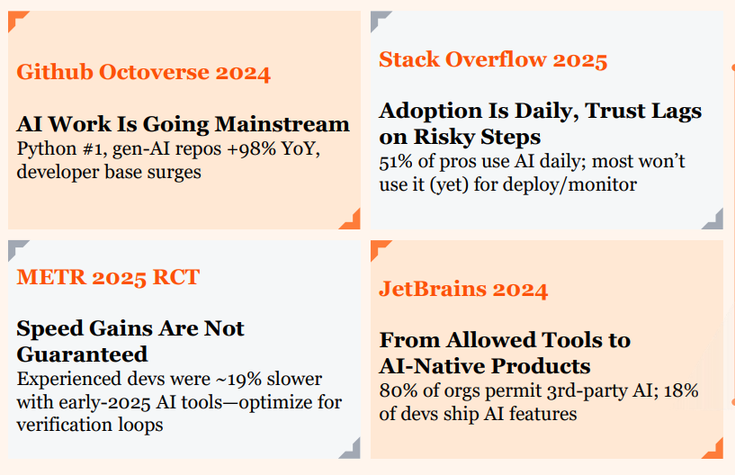
State of AI Adoption- 2025
Source:https://www.pwc.com/m1/en/publications/2026/docs/future-of-solutions-dev-and-delivery-in-the-rise-of-gen-ai.pdf

Slide 9
Software Development Leads AI Adoption
Adoption is real—but still mostly augmentative, not outright replacement.
36%
of software roles use AI for at least a quarter of their tasks
4%
use AI extensively across the bulk of their work
57%
of that AI usage augments the developer rather than replacing them
Source: Anthropic Economic Index — anthropic.com/news/the-anthropic-economic-index

Slide 10
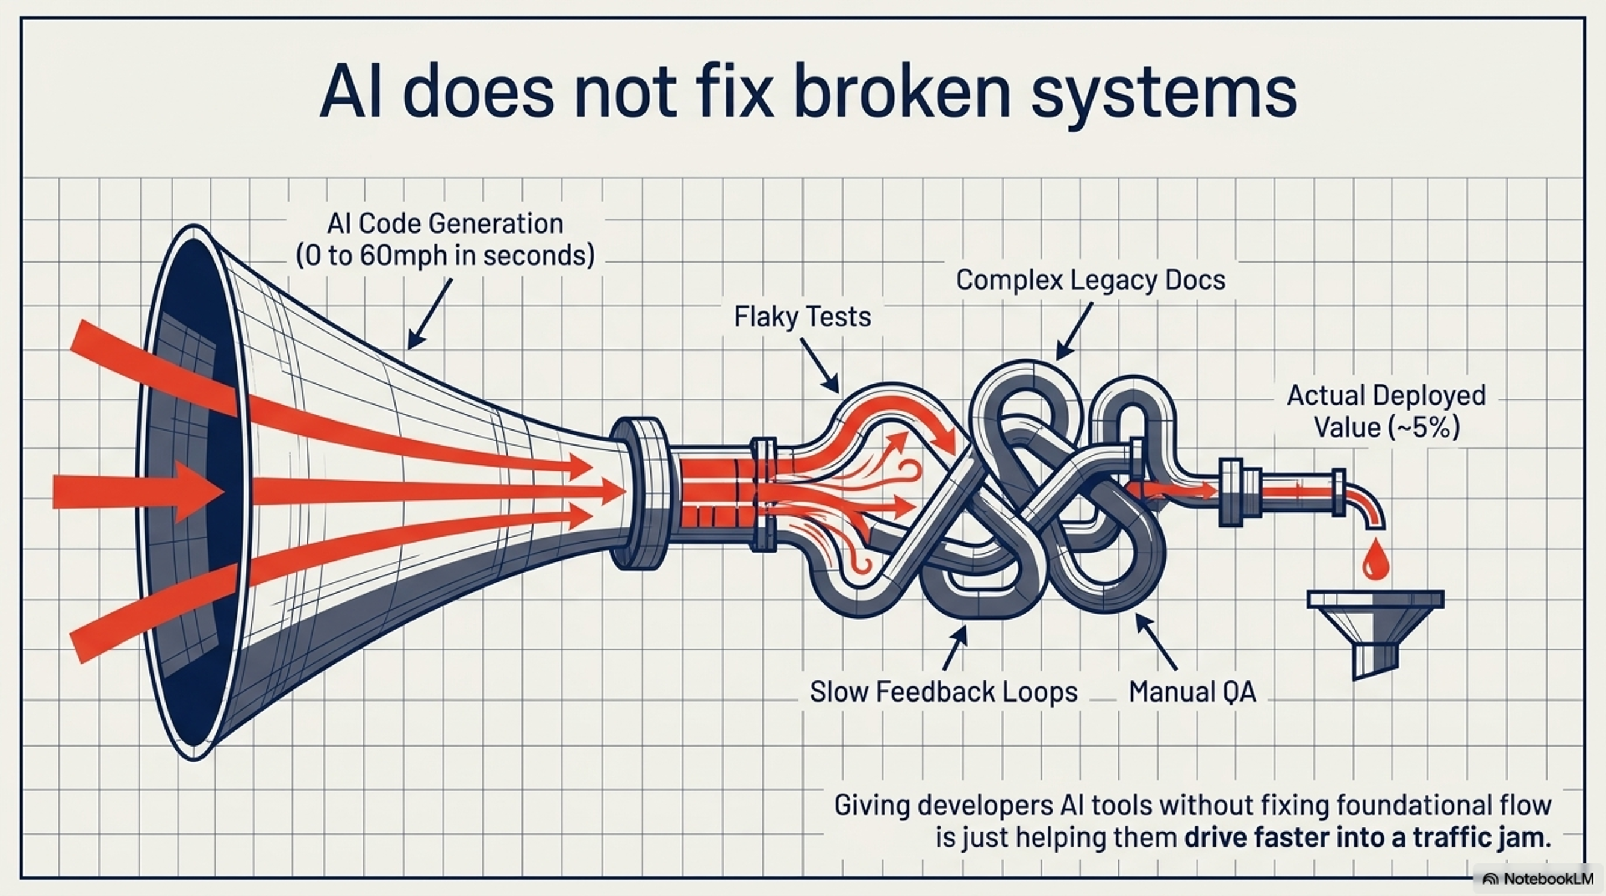
Capability(AI) vs Productivity(Actual deployed value)

Slide 11
40/60 split
How much time does a software developer spend writing code /core feature work?
40% of their time on core feature work, while the remaining 60% is consumed by "The Everything Else"

Slide 12
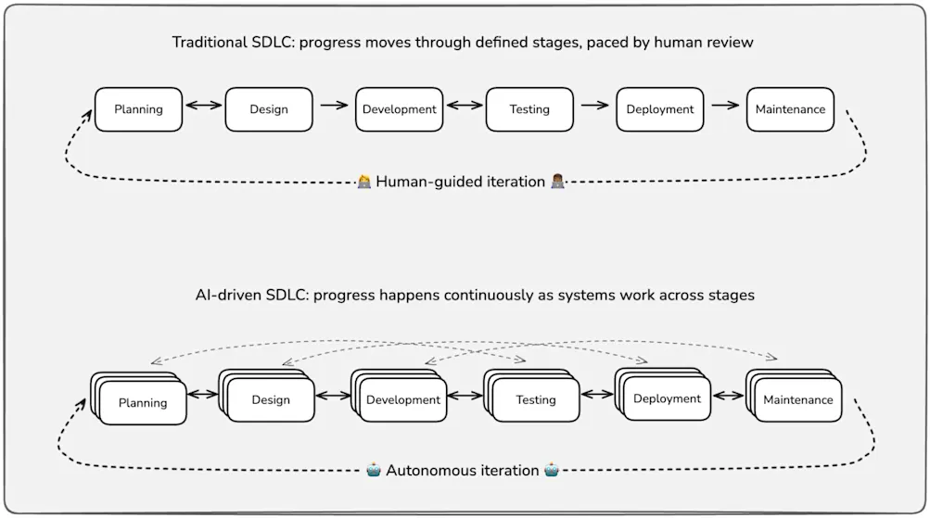
Traditional SDLC vs AI-driven SDLC

Slide 13
New challenges and constraints??
For all its benefits, the AI-driven SDLC introduces new constraints on the technical, organizational, and cultural levels.
How AI is reshaping every stage of the SDLC
How to adapt to AI-driven delivery

Slide 14
AI-augmented SDLC
Rethinking how we deliver software under AI acceleration
Evolution of SDLC models under AI acceleration; AI-driven change velocity and amplification of engineering risk; Impact of AI-assisted requirements analysis, design, coding, refactoring, testing, and review on lifecycle structure; Implications of developer AI interaction patterns on SDLC flow and control points; Rethinking limits, risks, validation strategies, and quality gates in AI accelerated lifecycles; Human-in-the-loop decision points across the lifecycle for quality, safety, and release control; Ownership and accountability in continuously changing systems; SDLC feedback loops from operations and incidents; Measuring lifecycle health through balanced indicators of productivity, quality, and reliability rather than speed alone.

Slide 15
Course Objectives
No | Course Objective
CO1 | Understand the evolution of software development life cycle models under AI acceleration and how AI-driven change velocity alters lifecycle structure, risk, and control points.
CO2 | Develop an understanding of AI fundamentals, prompt engineering, and agentic workflows required for applying AI tools effectively across software engineering tasks.
CO3 | Explore practical applications of AI tools across all engineering phases including requirements engineering, architectural design, coding, testing, refactoring, code review, and CI/CD
CO4 | Understand the need and learn to define governance mechanisms, validation strategies, human-in-the-loop decision points, and lifecycle health metrics for safe, accountable, and reliable AI-augmented software development.

Slide 16
Modular Content Structure
Module: 1 Foundations and Paradigm Shift – Evolution, Velocity, and Risk
Module: 2 Fundamentals of AI and Prompt Engineering
Module: 3 Requirements and Design
Module: 4 Coding and Refactoring
Module: 5 Testing and Quality Assurance
Module: 6 Deployment, CI/CD, and Release Management
Module: 7 Governance, Control Points, and Human-in-the-Loop
Module: 8 Operational Feedback Loops and Lifecycle Health

Slide 17
Evaluation
EC – 1 | Quiz – 1 and 2 | Online | 10% | 1 week
 | Assignment 1 and 2 | Online | 20 % | 10 days
EC - 2 | Mid-Semester Test | Closed Book | 30% | 2 hours
EC - 3 | Comprehensive Exam | Open Book | 40% | 2 ½ Hours

Slide 18
Thank you

